Slide 1
BANK CRM ANALYSIS
By Pranav Killedar

Slide 2
Table of contents
01
02
03
04
05
06
Introduction
Problem Statement
Data Discription
Objective and Subjective Key Matrics
Dashboard
Conclusion

Slide 3

Introduction
Analytical CRM Development for a Bank means creating advanced tools to make better decisions using customer data. This special system helps banks understand customers deeply, find trends, and use data to decide smartly. By using analytics, banks can group customers, see behaviors, predict future actions, and track changes well.
The aim is to make customers happier and keep them longer by personalizing offers and campaigns based on data. Analytical CRM in banking is key to understanding how customers act, improving how banks work, and building strong, lasting customer relationships.

Slide 4

Problem Statement
Customer churn, which is how many customers stop using our bank's services, is a critical issue affecting our revenue and profits.
This presentation will analyze our bank's customer churn rates. We'll look at factors like gender, recent years, customers with credit cards, number of products they use, credit scores affecting churn, and where customers are leaving from.
Our goal is to find out why customers leave and suggest ways to keep more customers happy and staying with us.

Slide 5
Data Description
CustomerId: A unique identifier for each customer.
CreditScore: A numerical representation of the customer's creditworthiness.
Credit score:
Super Prime: 721–850
Prime: 661–720
Near Prime: 621–660
Sub Prime: 581–620
Deep Subprime: <580
GeographyID: A numerical identifier that likely corresponds to a geographical location, such as a country or region.
GenderID: A numerical identifier for the customer's gender, where for example, '1' could represent male and '2' could represent female.
Age: The age of the customer.
Tenure: The number of years the customer has been with the bank.

Slide 6
Data Description
Balance: Current balance in the customer's account.
NumOfProducts: refers to the number of products that a customer has purchased through the bank.
HasCrCard: denotes whether or not a customer has a credit card. This column is also relevant, since people with a credit card are less likely to leave the bank.
1 represents credit card holder
0 represents non credit card holder
IsActiveMember: active customers are less likely to leave the bank (as per the criteria defined by the bank for identifying the activeness).
1 represents Active Member
0 represents Inactive Member
Estimated Salary: as with balance, people with lower salaries are more likely to leave the bank compared to those with higher salaries.
Exited: whether or not the customer left the bank.
0 represents Retain
1 represents Exit
Bank DOJ: date when the Customer associated/joined with the bank.

Slide 7
Objective and Subjective Key Matrics

Slide 8
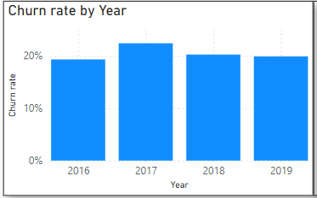
Churn Rate Analysis by Year
Analysis :-
From 2016 to 2019 the average churn rate across the four years is 20%. This isn’t ideal, as a lower churn rate is preferable.
A high churn rate can indicate that customers are unhappy with the service or that they are not finding it valuable.
Recommendation :-
Offer incentives for customers to stay with your service. This could include discounts, free trials, or other perks.
Improve your customer service. Make sure that your customers are happy with the level of service they are receiving.
By taking steps to reduce churn, you can improve the health of your business.

Slide 9
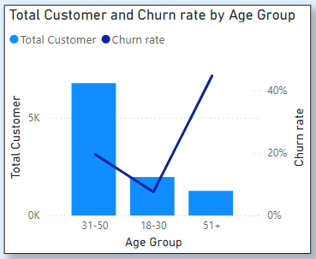
Total Customer and Churn Rate by Age Group
Analysis :-
The chart shows that the total number of customers is higher than the churn rate across all age groups.
Churn rate appears to be highest for the 18-30 age group. It then dips for the 31-50 age group, before rising again for the 51+ age group.
Recommendations :-
Investigate why the 18-30 age group has the highest churn rate.
Implement strategies to target the 18-30 age group such as Offering targeted discounts or promotions.
Consider offering loyalty programs or tiered subscriptions to incentivize users to stay with the service for a longer period.

Slide 10
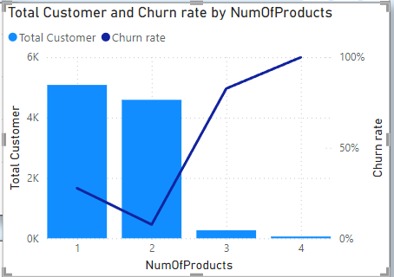
Total Customer and Churn Rate by Num of Products
Analysis :-
The chart shows that as customers buy more products, both the total number of customers and the churn rate go up.
However, the number of new customers is growing faster than the number of customers leaving. This means that we're gaining new customers who buy more products faster than we're losing existing ones.
Recommendation :-
Focus on upselling and cross-selling to existing customers, especially those who already purchase multiple products.
Provide excellent customer service to those who buy more products to reduce churn among this valuable customer segment.

Slide 11
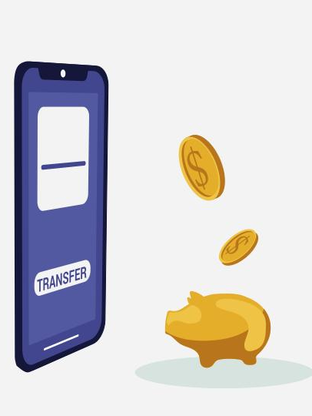
Key Insights
Germany is the highest financial risk for the bank due to the highest churn rate (814) and the fewest active members (1248).
France has the most active members (2591).
Spain has the fewest customers who have left (413).
There's no strong link between the number of active members and their average estimated salary.
Women (0.25) leave the bank at a higher rate than men (0.16).
Customers with poor credit scores (300-579) have the highest exit rate.
Having a credit card doesn’t significantly affect churn rates.
Most customers who leave the bank have only one product.
Many customers join the bank from August to December.
People aged 30-50 have the most credit cards.

Slide 12
Factors Contributing to Bank Churn
Customer Satisfaction: Low satisfaction can cause customers to leave. Common reasons for dissatisfaction include poor customer service, long wait times, and unresolved issues.
Fees and Charges: High fees can drive customers away. If a bank's fees are much higher than competitors or seem unfair, customers might switch to another bank.
Competition: Strong competition can also cause customers to leave. If a competitor offers better rates, perks, or a better user experience, customers might be tempted to switch.

Slide 13

Strategies and Recommendations
Personalized Offers: Tailored offers and incentives are provided based on customer preferences and behavior to encourage retention.
Customers Loyalty Programs: Traditional loyalty programs reward customers for their continued business and encourage them to stay with the bank.
Improved Customer Service: Enhancements are made to the customer service experience to improve satisfaction, resolve issues effectively, and address customer feedback.

Slide 14
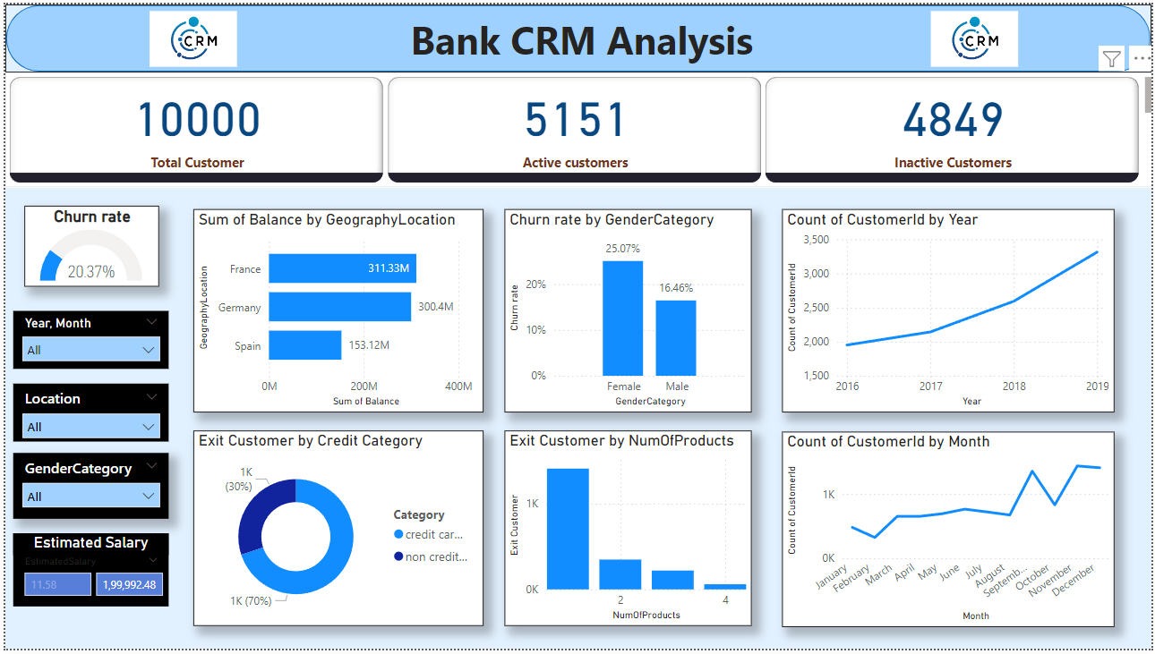
Dashboard

Slide 15
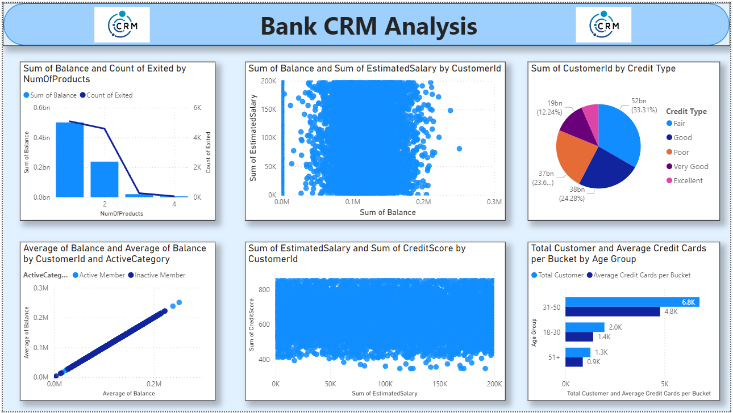
Dashboard

Slide 16
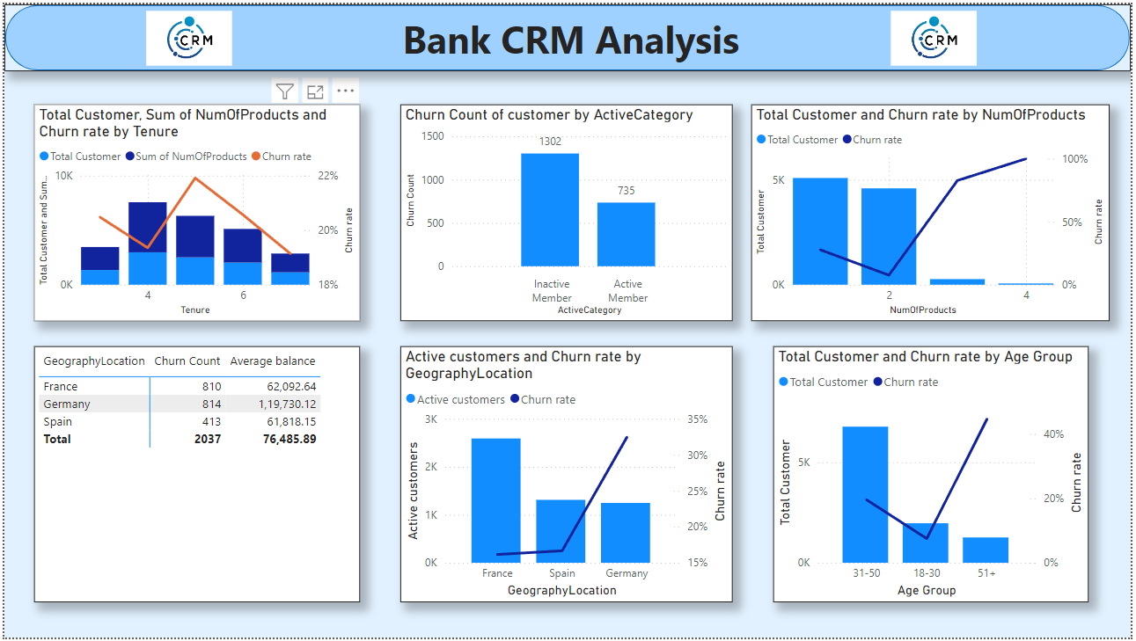
Dashboard

Slide 17
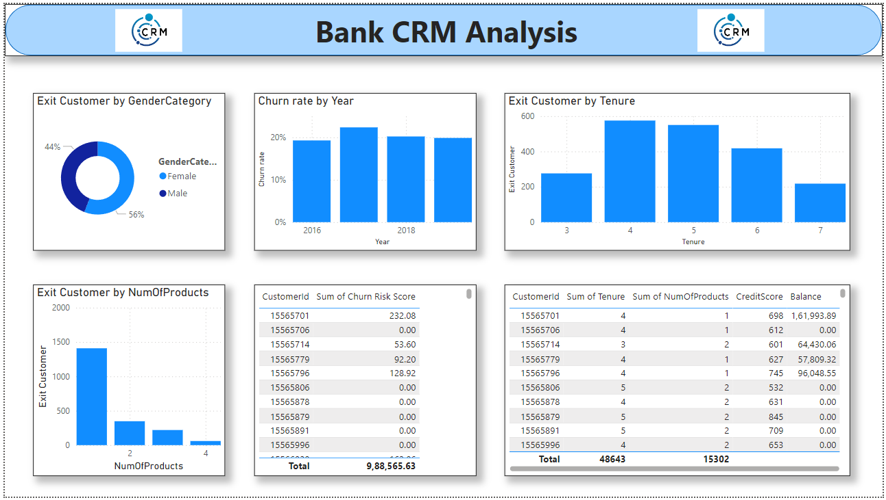
Dashboard

Slide 18

Conclusion
Customer churn remains high despite acquiring new customers, highlighting a need for better retention strategies.
Focus on specific customer segments: Customers with lower credit scores, those using fewer products, and older age groups require targeted efforts to improve retention.
Key strategies to reduce churn: Enhance customer engagement, improve customer service, and offer competitive products and services.
Targeted marketing and personalized offers are crucial to retain customers in critical segments.
By addressing these points, the bank can achieve reduced churn, improved retention, and stronger customer loyalty.

Slide 19

Thank You..!

